Slide 1
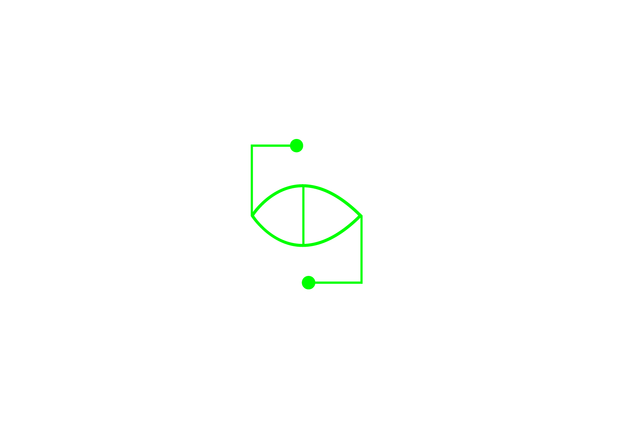
Neural Networks
Emulating the human brain
Reboot.ai

Slide 2
Agenda
Who: Who is behind Reboot.ai?
Why: What problems do neural networks (NN) solve?
What: What are NNs anyway?
How: How do NNs work?
High Level Description
Technical Deep Dive and Special Cases
Code Walkthroughs
Q&A

Slide 3
About Reboot.ai
Who?
Matt O’Connor
BBA Finance
Previous: Lead Trader Algorithmic Desk - Macro Hedge Fund
Current: Full stack developer and professional Scrum Master (PSM I)
Avid futurist –social ramifications of AI & blockchain
Dhruv Sahi
BA Mathematics and Economics
Previous: Data Science Chief – Smart Cities Startup
Current: Business Intelligence Analyst – eCommerce - Grana
AI, IoT, and smart cities enthusiast
Reboot.ai
Hong Kong’s only dedicated machine learning and AI training provider
Part time evening courses for beginners and advanced
Curriculums developed in partnership with local data companies
Use ML & AI in our classrooms to improve teaching and personalize learning

Slide 4

But Why Neural Networks?
Why?
1) The universe is complex…
Non-linearity and >3 dimensional data structures
Cases for which no mathematical model (yet) exists
2) Flexible and data type agnostic
In theory can solve any type of problem
Ex. NLP, image recognition, time series prediction
3) ‘Self teaching’
Don’t have to be explicitly programmed
Unlike most forms of experimentation, don’t require working hypothesis by human controller

Slide 5
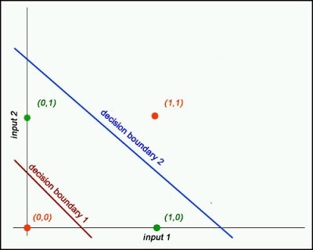
1) Complex Data - Problem
Why?
Notes:
Slides to illustrate complexities of modern problems, how traditional methods either can’t solve or aren’t optimal to solve
Here simple example of multi-dimensional categorization problem, impossible to capture with only one linearity

Slide 6
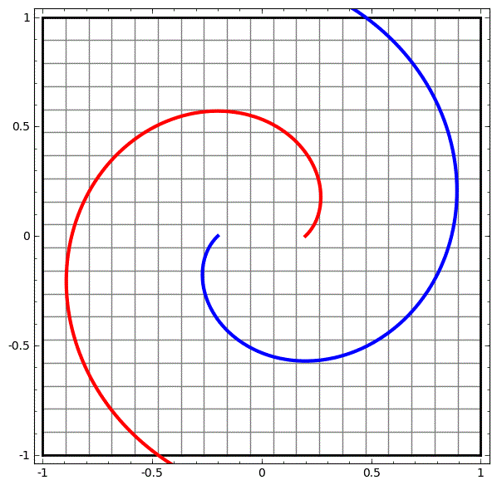
1) Complex Data - Problem
Why?
Notes:
can’t be separated as currently expressed in two dimensions
But machines are excellent at squashing and expanding data through dimensions (next slide gif)

Slide 7

1) Complex Data - Solution
Why?

Slide 8
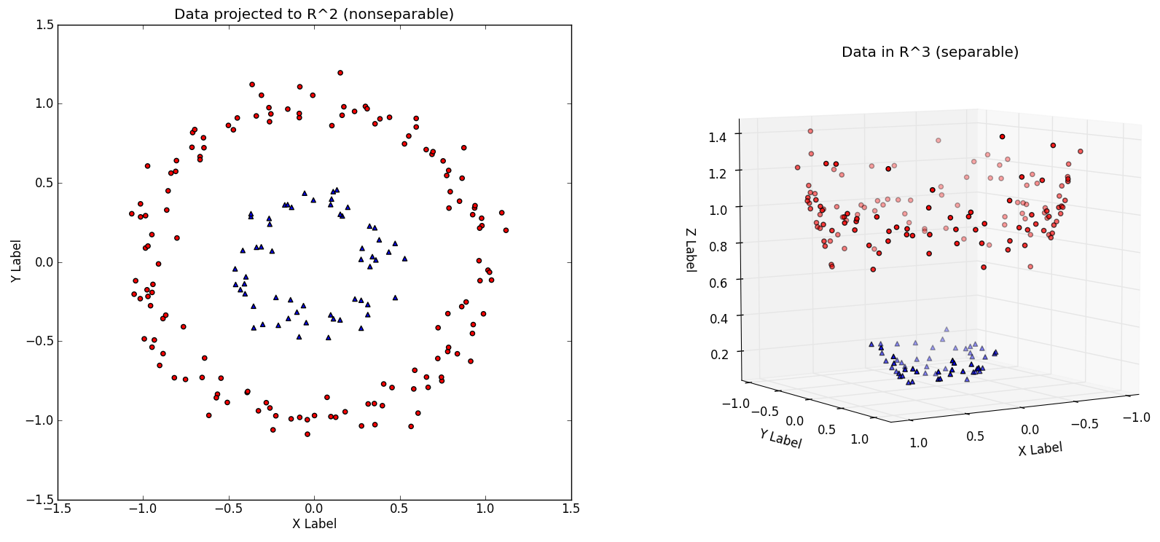
1) Complex Data - Solution
Why?
Notes:
- Another illustration of this point, not separable in 2D…

Slide 9
1) Complex Data - Solution
Why?
Notes:
- But easily so in 3D

Slide 10
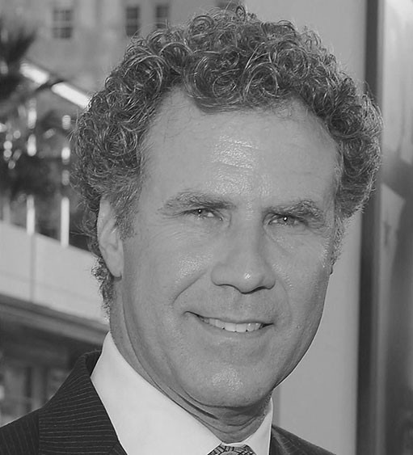
2) Flexible – Image Recognition
Why?
Notes:
NN handle anything that can be quantified
NLP and image recognition are not magic, break down example into quantified parts to illustrate why NN are so useful, can be applied to anything quantified and virtually everything can be quantified

Slide 11
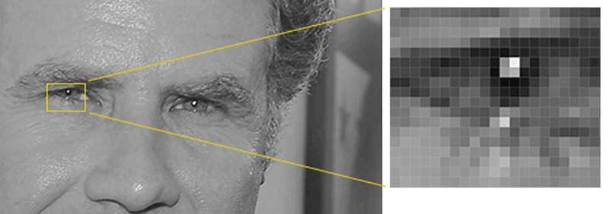
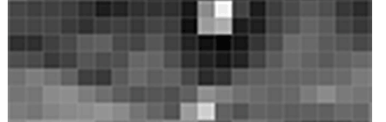
2) Image Recog - Pixel Vectors
Why?

Slide 12

2) Image Recog - Gradient Vectors
Why?

Slide 13
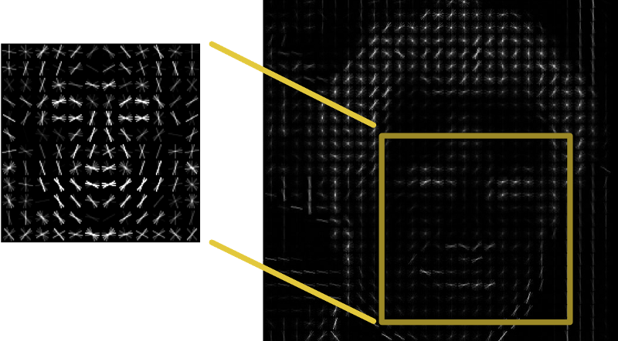
2) Image Recog - Gradient Vectors
Why?

Slide 14
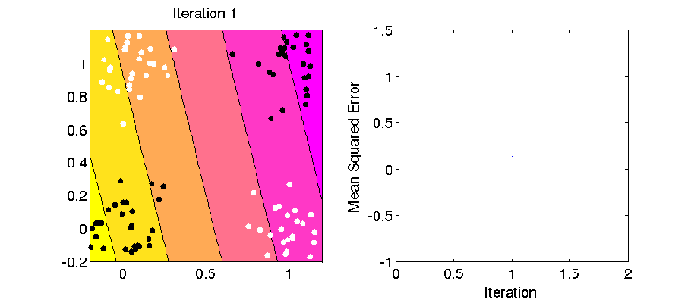
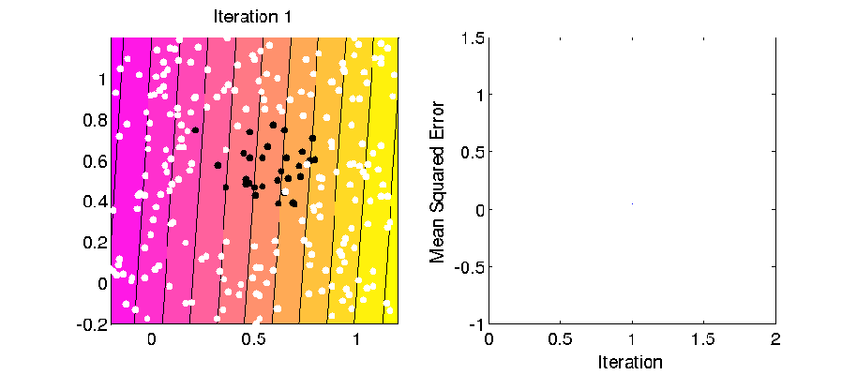
3) Self Teaching
Why?
Notes:
- Error minimizing functions over time

Slide 15

3) Self Teaching
Why?
Notes:
- 3D representation of such

Slide 16
Summary: Why?
Why?
Benefits
Allow for extremely complex cases
More ‘practical’ than elegant mathematical solutions
Less intensive development time up front
Flexibility
Weaknesses
Relatively computationally expensive vs standard methods/agorithms
More ‘black box’, intermediate results can not necessarily be interpreted by humans
Skynet? - harder to ‘control’ and less intuitive heuristics than other methods
Questions at this point?

Slide 17
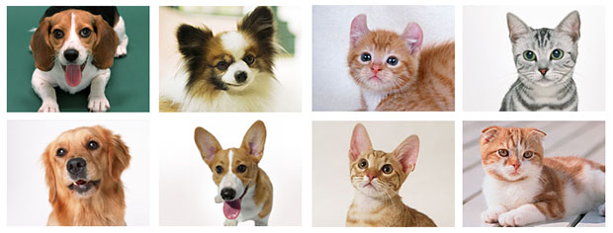
So What Are Neural Networks?
What?
Notes:
What do people see? Dogs and cats, ears, fur, creatures with a bulbous head region and oblong body region
Point is to explain how human brain works, how neurons fire and work

Slide 18
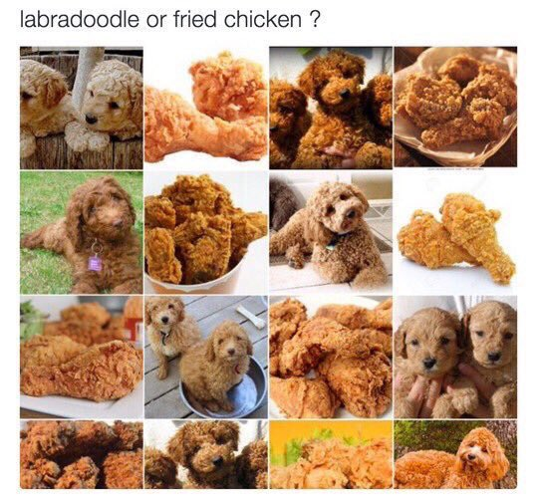
So What Are Neural Networks?
What?
Notes:
- Further illustrate this point, describing how different neuron clusters/layers perceive different characteristics and fire to neighboring neurons

Slide 19
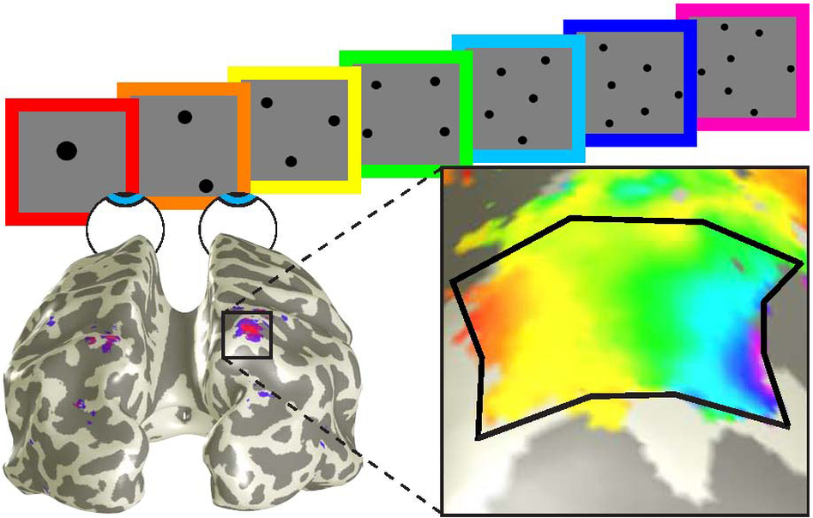
So What Are Neural Networks?
What?
It’s a doggerz!
Head
Eyes
Light and Dark
Irregular
Textured
Brown

Slide 20
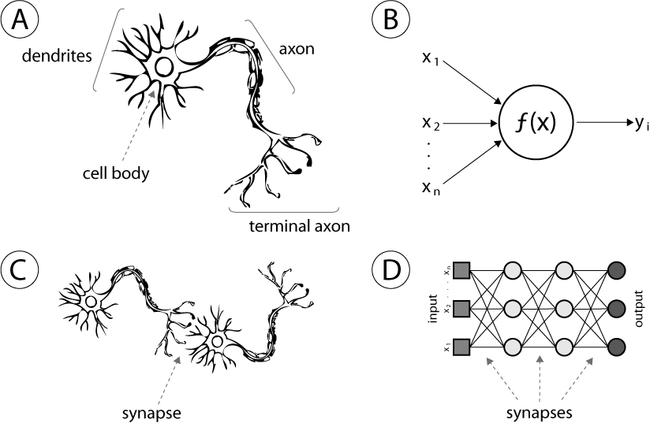
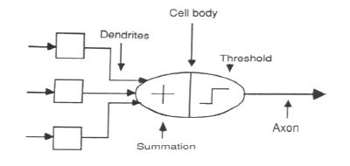
More Human Than Human
What?
Like brains, NNs are:
Pattern recognition functions - prediction, classification, generation
Error minimizing (learning)
General frameworks which can express anything
NNs are biological emulation, not mathematical formula/model
Neurons
Layers

Slide 21
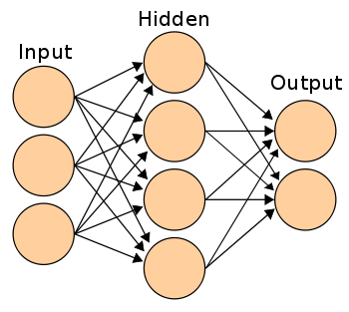
Hidden Layers & ‘Deep’ Learning
What?

Slide 22
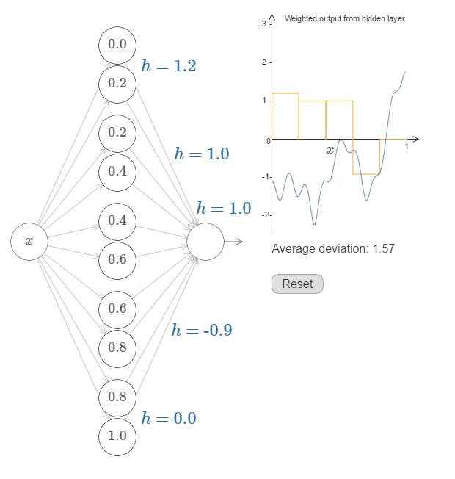
The Whole > Sum of Parts
What?

Slide 23
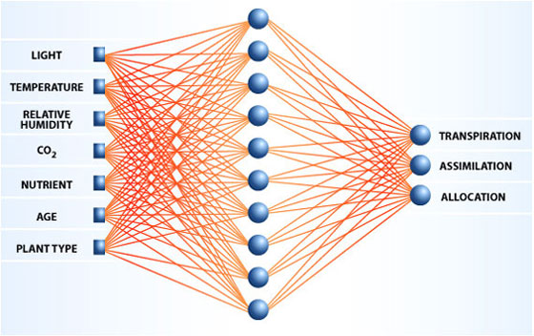
Deeper Dive – Basic Neural Networks
What?

Slide 24
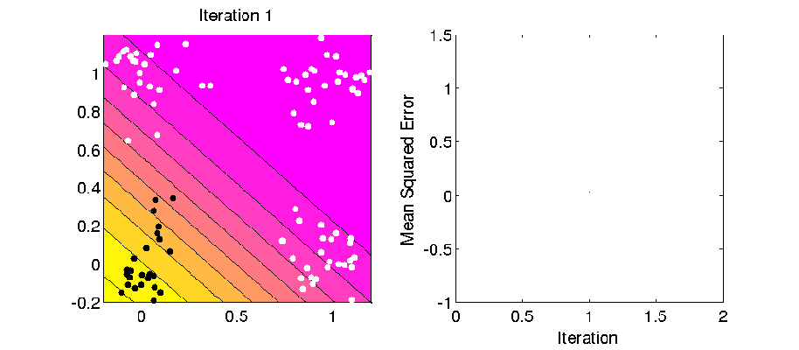
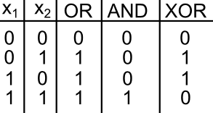
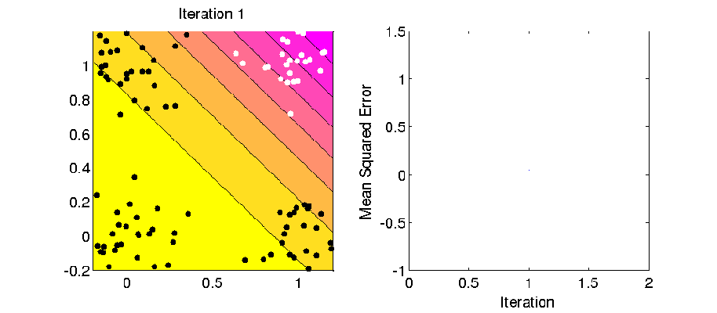
Deeper Dive – Perceptrons
What?

Slide 25
Deeper Dive - Special Cases
What?
Convolutional
Recurrent
Used for image recognition
Uses overlapping data to find abstracted ‘features’ ie… a nose, a stop sign, a dog, etc.
Pattern recognition independent of setting
Used for time series and heavily in Natural Language Processing (NLP)
Same layer nodes interconnected so they are contextually dependent
‘Remember’ outputs and inputs of neighboring neurons

Slide 26
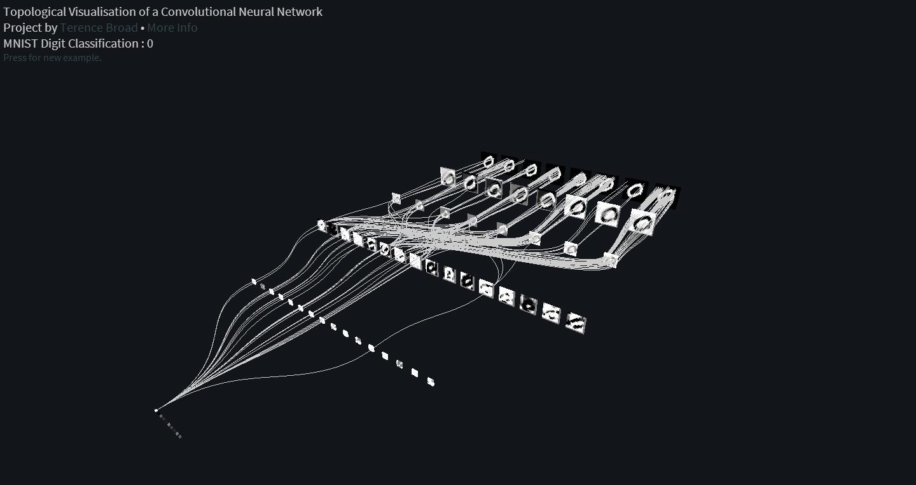
Special Case - Convolutional
What?

Slide 27
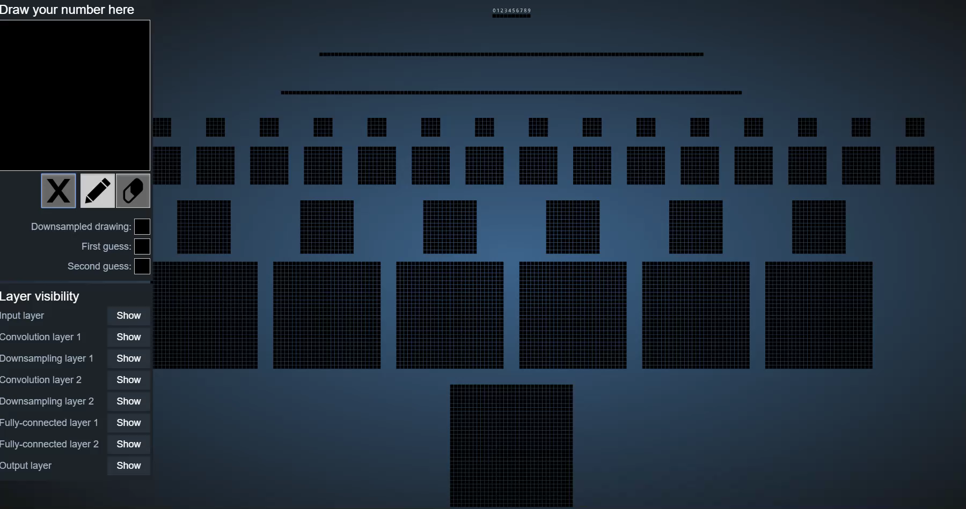
Special Case - Convolutional
What?

Slide 28
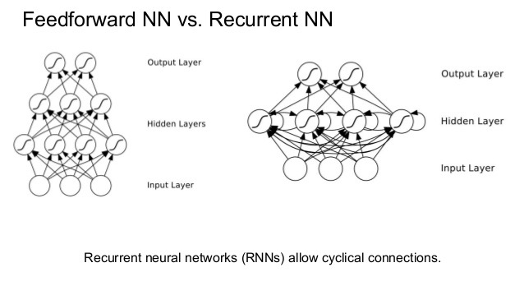
Special Case - Recurrent
What?

Slide 29
Summary: What?
What?
High Level
‘Ground up’ emulation of the human brain
Can be used predict, categorize, or generate
If it can be quantified, a neural net can be used – but not always best choice
Deeper Dive
Each ‘neuron’ can thought of as a voter whose weighted votes generate an output
Convolutional NN are used for image recognition
Recurrent NN are used in NLP and time series prediction
Many other special sub-cases exist (or are being developed)
Questions at this point?

Slide 30
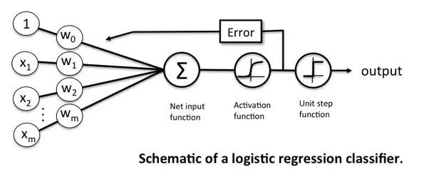
How Do NNs Work? - Components
How?
Input layer
Weights from input layer to hidden layer (if any)
Weights from hidden layer (if any) to output layer
Activation Function
Output layer

Slide 31
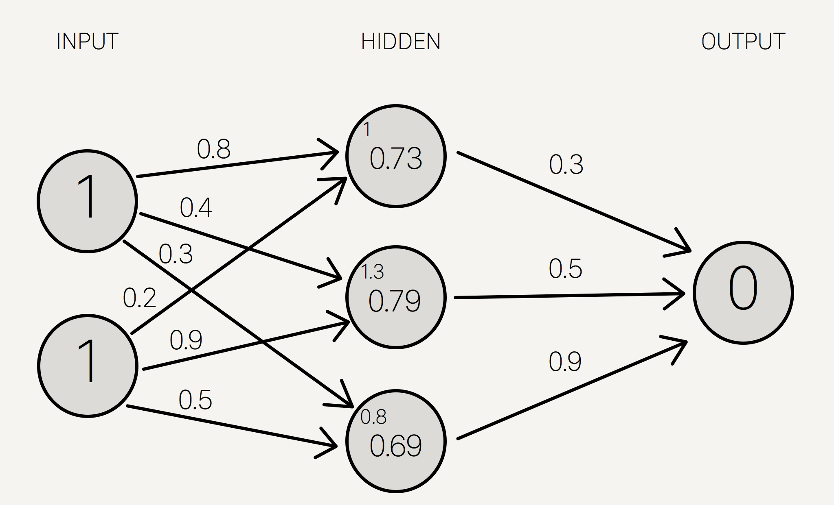
Process
How?
Feed data forward
Multiply inputs by weights
Sum at each hidden node
Run sum through activation function
Take output and multiply by weights…
Measure error
Measure output vs expected (given)
Calc direction and magnitude
Update weights
Propagate error back through proportionally
Change weights and repeat

Slide 32
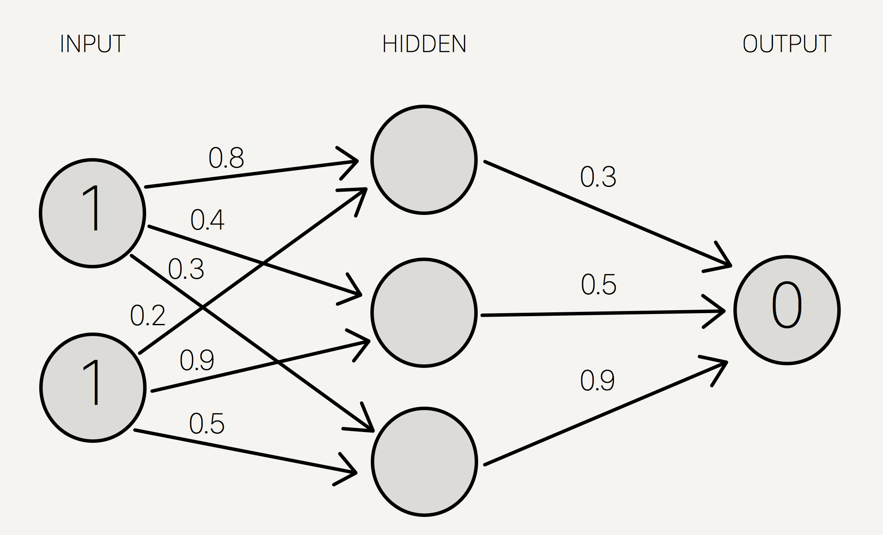
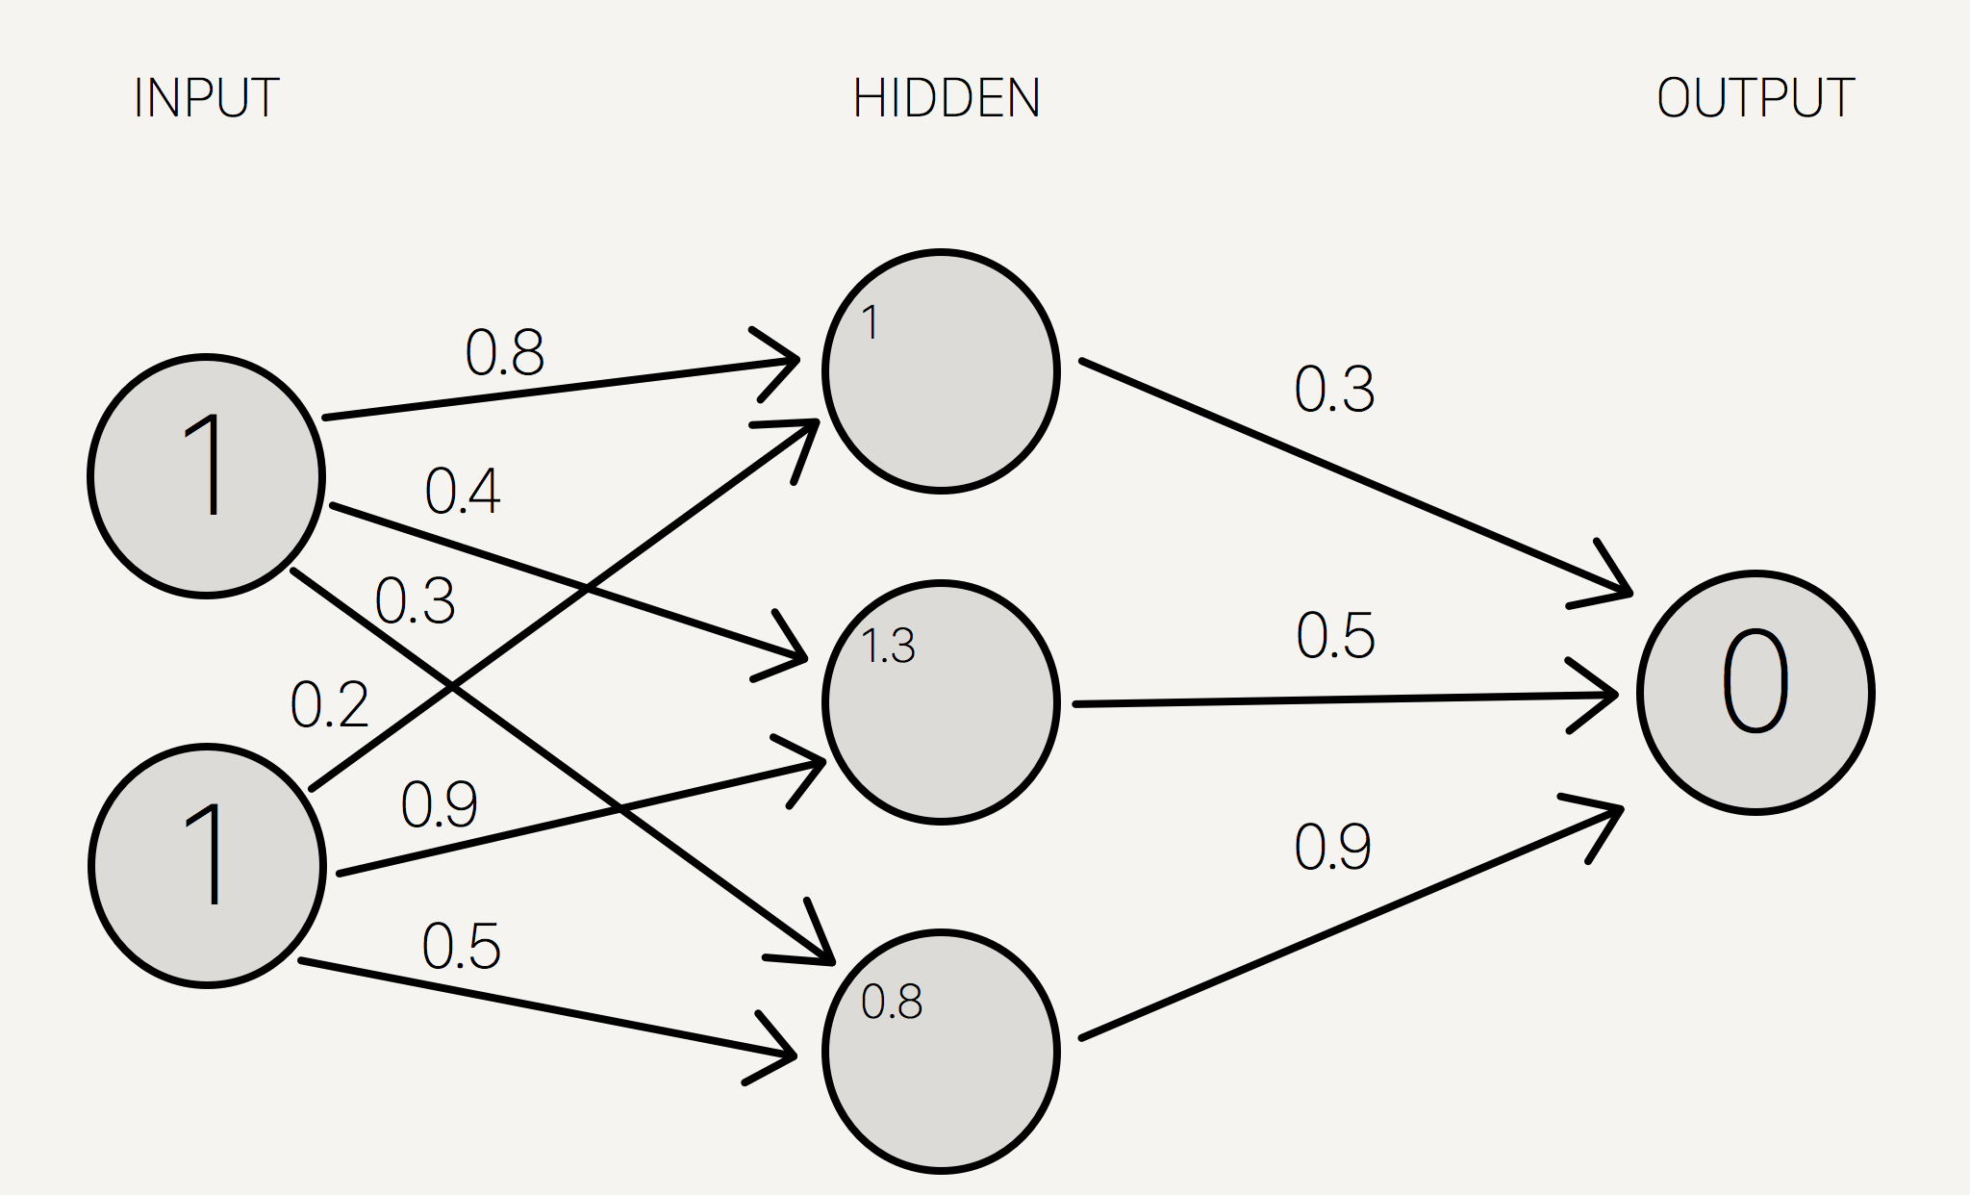
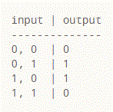
Deeper Dive – First Layer
How?

Slide 33
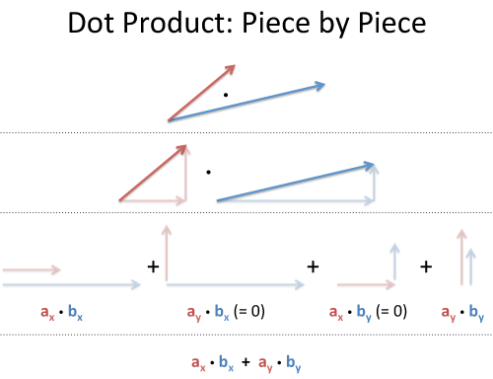
Deeper Dive – Forward Propogation
How?

Slide 34
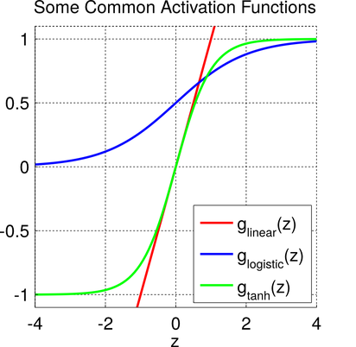
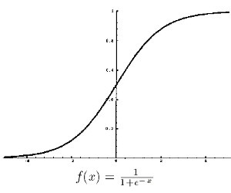
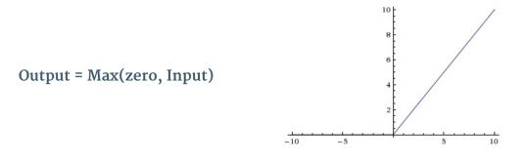
Deeper Dive - Activation
How?

Slide 35
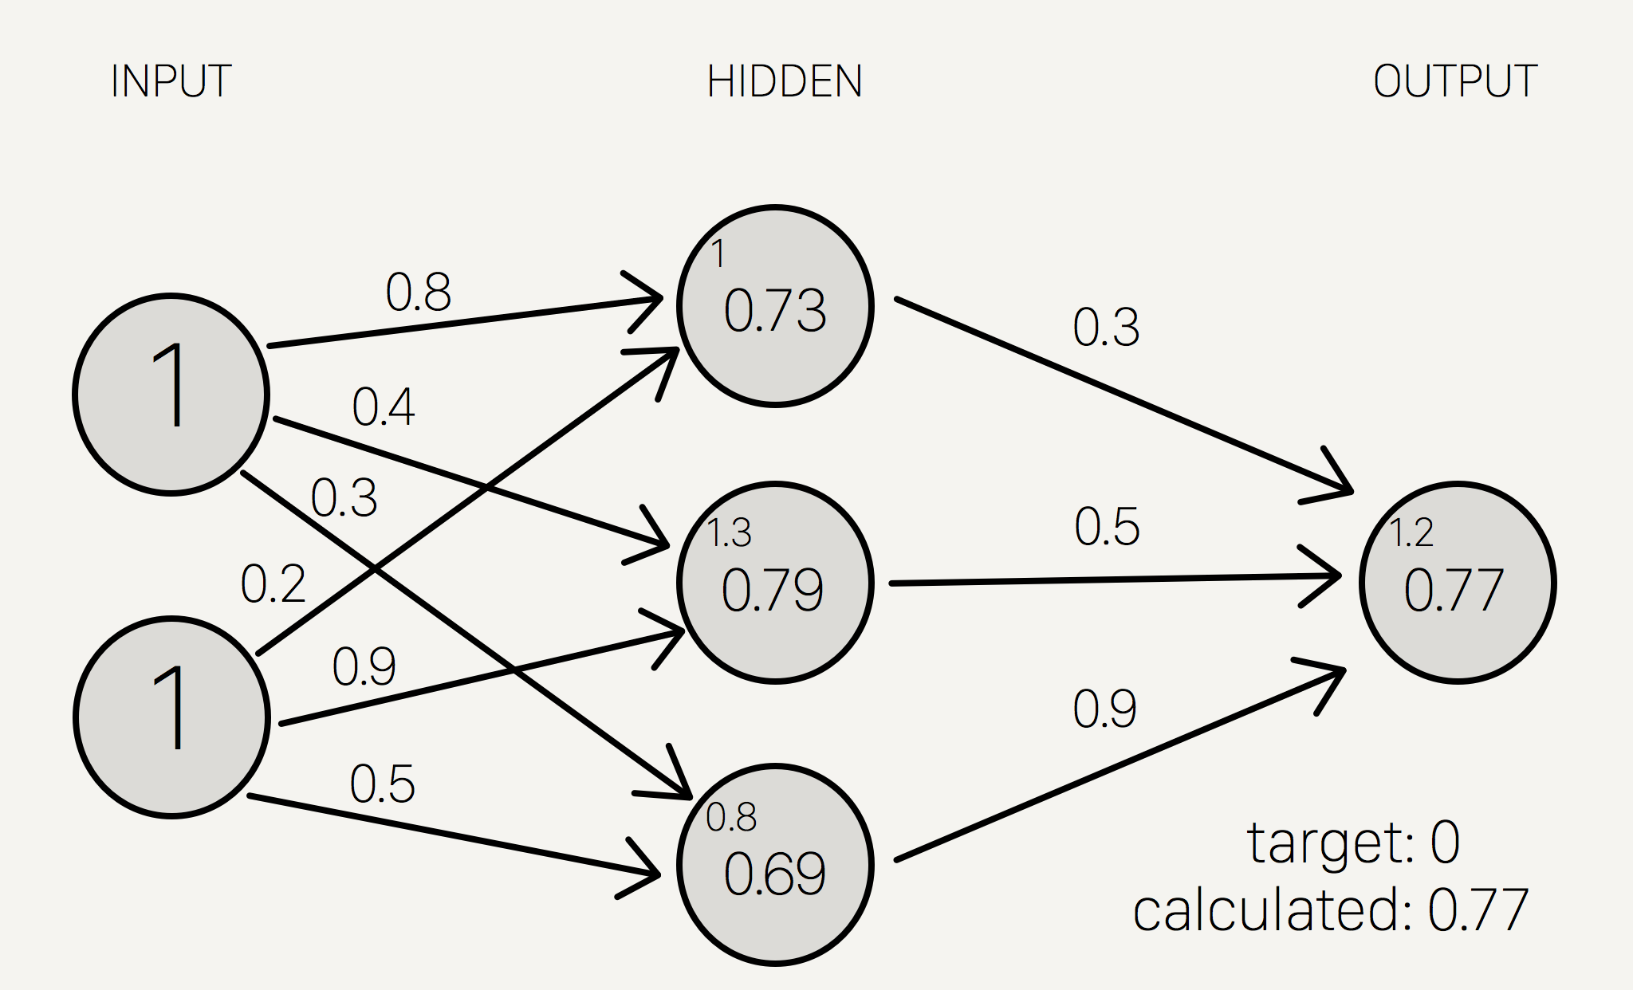
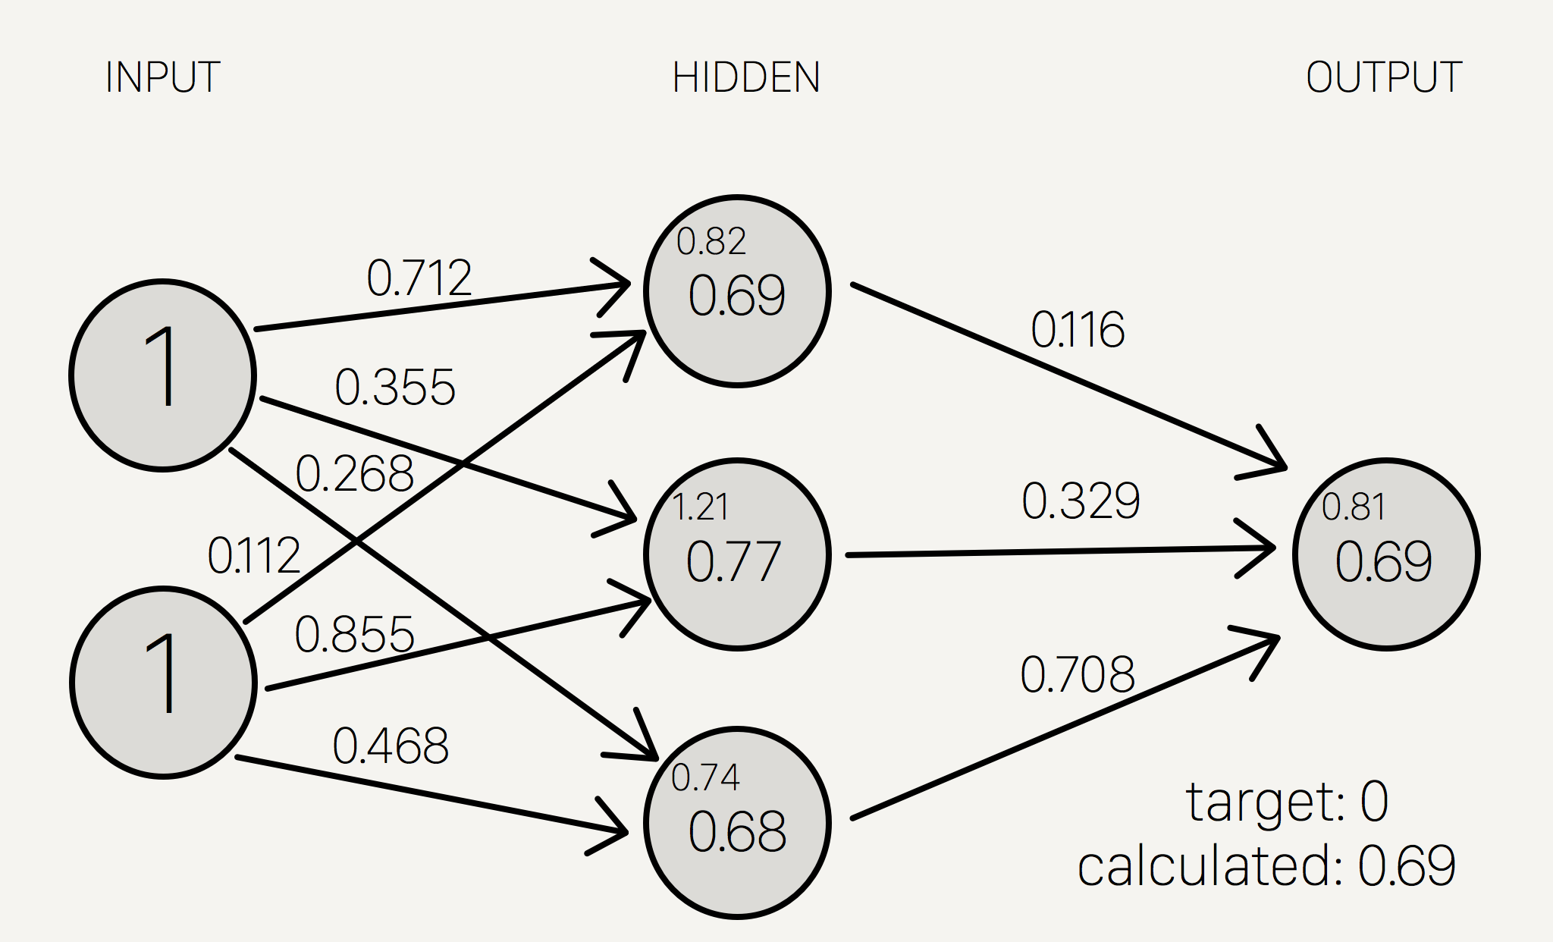
Deeper Dive – Error
How?

Slide 36
Deeper Dive – Backward Propogation
How?
Backward Propogation
Have direction of error (+/-)
Have slope (gradient) from point of activation and tangent line
From these two, we can calculate an ‘error term’ that indicates both what direction to update weights and by how much
Implement algorithm like Gradient Descent or Stochastic Gradient Descent to minimize error

Slide 37
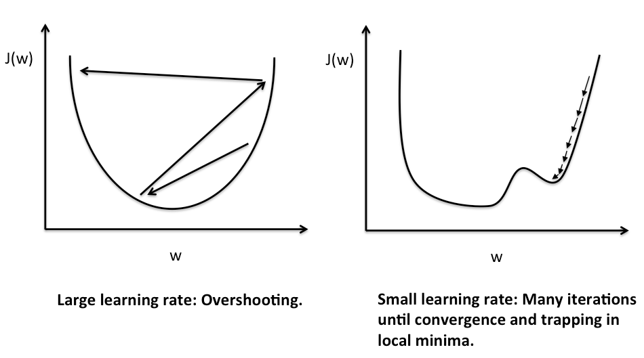
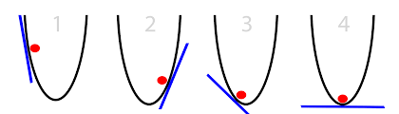
Deeper Dive – Gradient Descent
How?

Slide 38
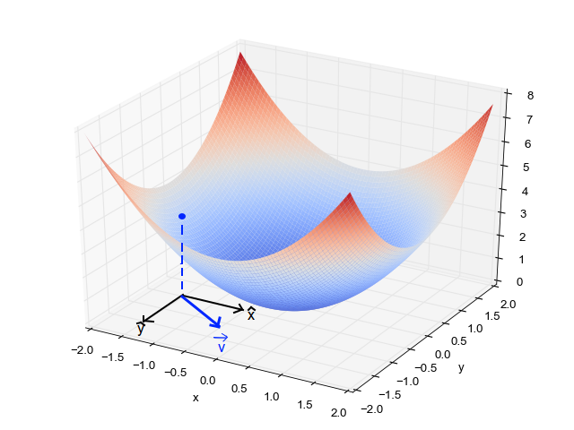
Deeper Dive – Gradient Descent
How?

Slide 39
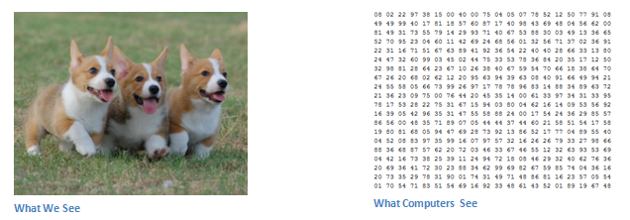
Special Cases - Convolutional
How?

Slide 40

Special Cases - Convolutional
How?

Slide 41
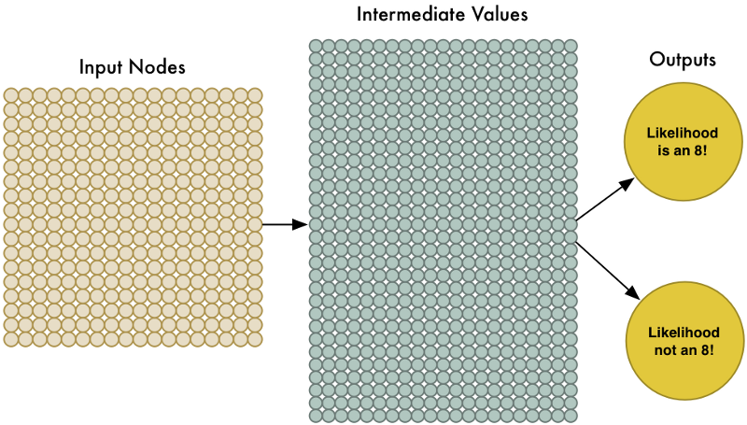
Special Cases - Convolutional
How?

Slide 42
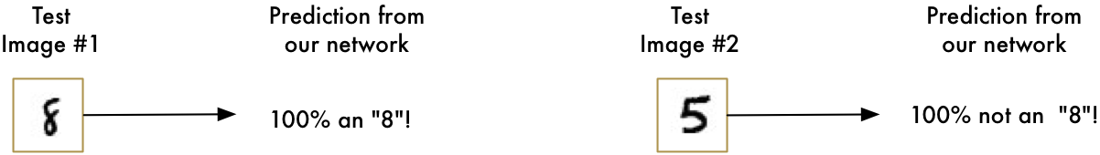
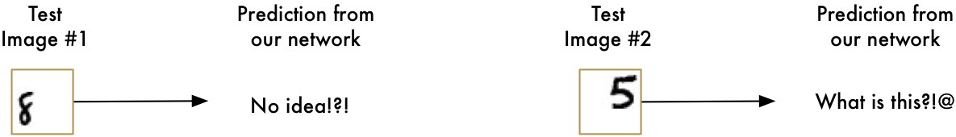
Special Cases - Convolutional
How?

Slide 43
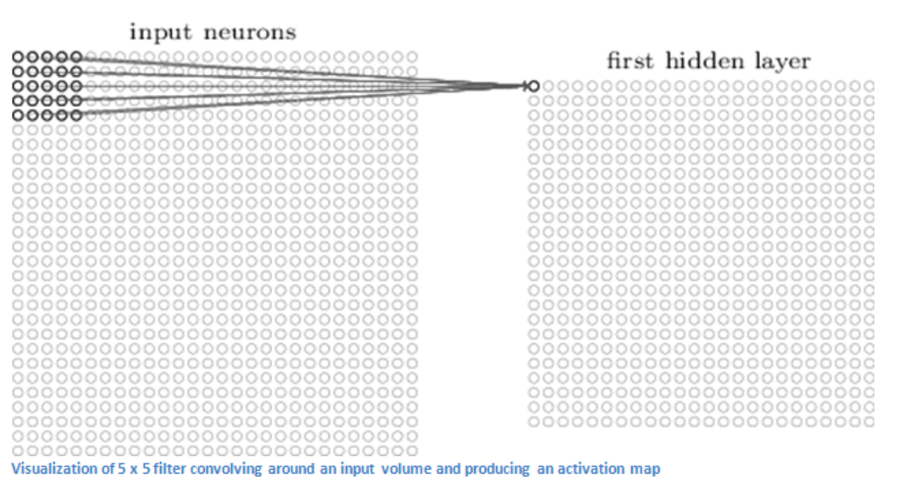

Special Cases - Convolutional
How?

Slide 44


Special Cases - Convolutional
How?

Slide 45
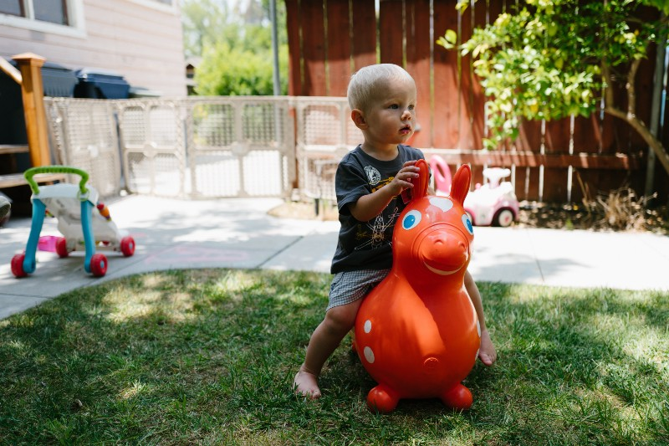
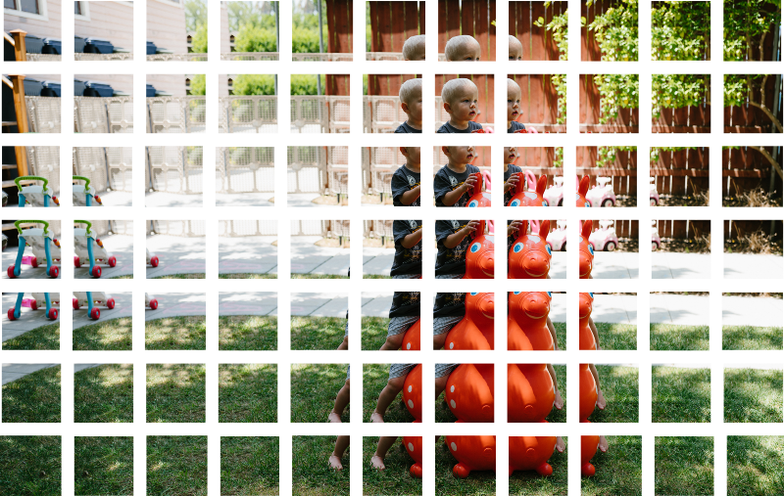
Special Cases - Convolutional
How?

Slide 46
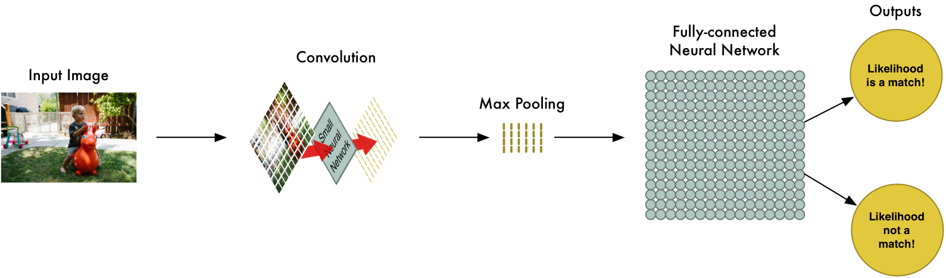
Special Cases - Convolutional
How?

Slide 47
Convolutional NN – Code
How?
Build an example CNN in Python using Keras
Will distribute file so no need to code along
Questions so far?

Slide 48
More at http://Reboot.ai
Q&A
Hong Kong’s premier machine learning and AI training provider
Part time evening courses for beginners and advanced
Curriculums developed in partnership with local data companies
Use ML & AI in our classrooms to improve teaching and personalize learning
Dhruv Sahi
5572 8474 dhruvsahi@gmail.com
linkedin.com/in/dhruv-sahi
Matt R O’Connor 6289.9447 matt.oconnor217@gmail.com linkedin.com/in/mattroconnor

Slide 49
Resources
http://mccormickml.com/2014/03/04/gradient-descent-derivation/
http://eli.thegreenplace.net/2016/understanding-gradient-descent/
https://theclevermachine.wordpress.com/2014/09/06/derivation-error-backpropagation-gradient-descent-for-neural-networks/
https://arxiv.org/pdf/1701.01887.pdf
https://ujjwalkarn.me/2016/08/11/intuitive-explanation-convnets/
http://karpathy.github.io/2015/05/21/rnn-effectiveness/
https://stevenmiller888.github.io/mind-how-to-build-a-neural-network/
https://theclevermachine.wordpress.com/2014/09/11/a-gentle-introduction-to-artificial-neural-networks/
https://www.quora.com/What-is-the-role-of-the-activation-function-in-a-neural-network
https://theclevermachine.wordpress.com/2014/09/11/a-gentle-introduction-to-artificial-neural-networks/
https://www.quora.com/Why-do-neural-networks-with-more-layers-perform-better-than-a-single-layer-MLP-with-a-number-of-neurons-that-leads-to-the-same-number-of-parameters
http://neuralnetworksanddeeplearning.com/chap4.html
https://ujjwalkarn.me/2016/08/11/intuitive-explanation-convnets/
http://scs.ryerson.ca/~aharley/vis/conv/flat.html
https://medium.com/@ageitgey/machine-learning-is-fun-part-3-deep-learning-and-convolutional-neural-networks-f40359318721

